Slide 1
Fundamentals of AI & Machine Learning
Eng- Mohamed Khaled Idris
Eng- Mayar Swilam

Slide 2
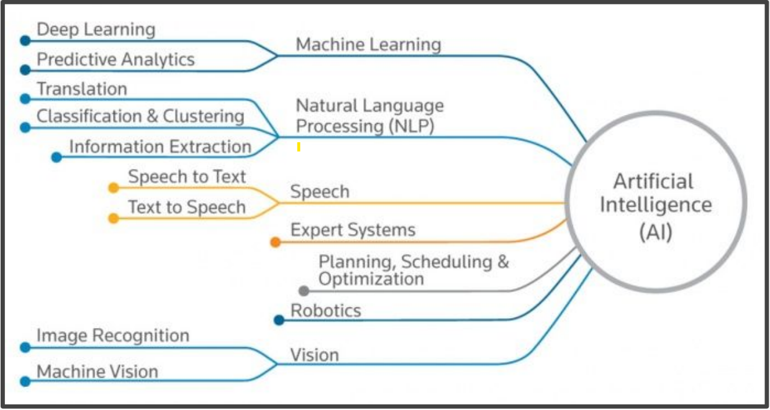

Slide 3
What is Machine Learning ?
Machine learning is a field of artificial intelligence (AI) that involves developing algorithms and statistical models that enable computers to learn and improve from experience, without being explicitly programmed.

Slide 4
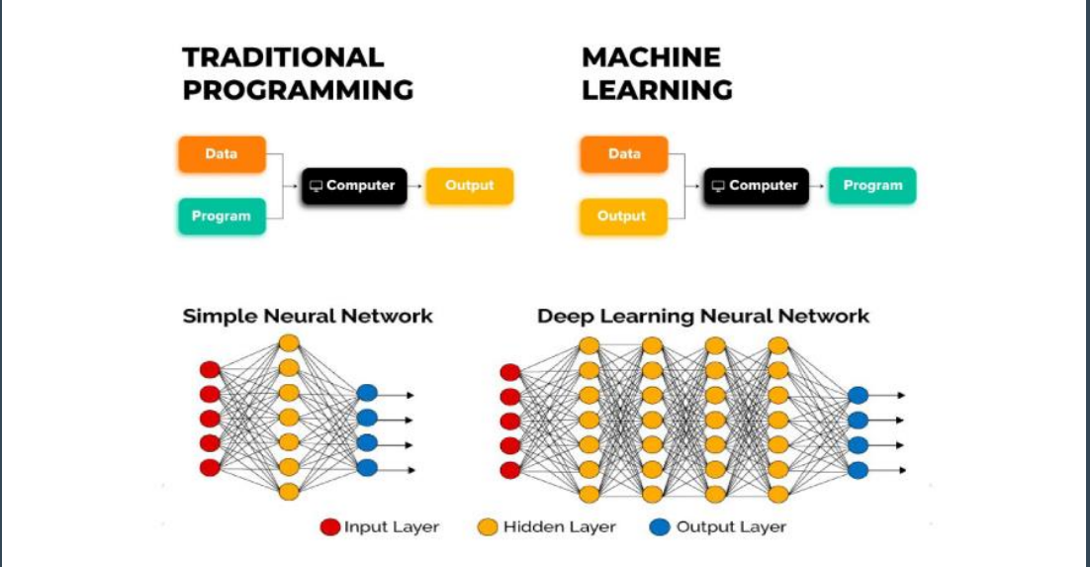

Slide 5
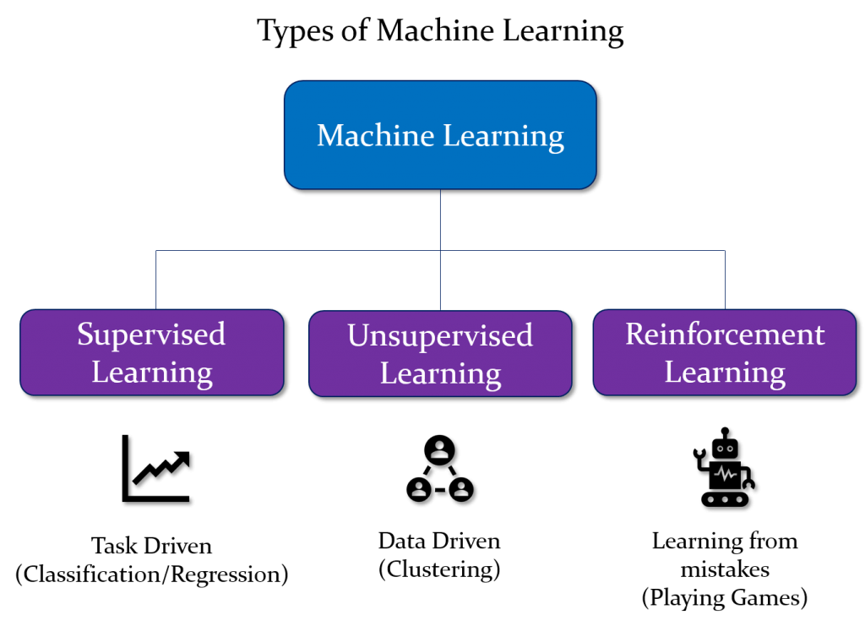

Slide 6
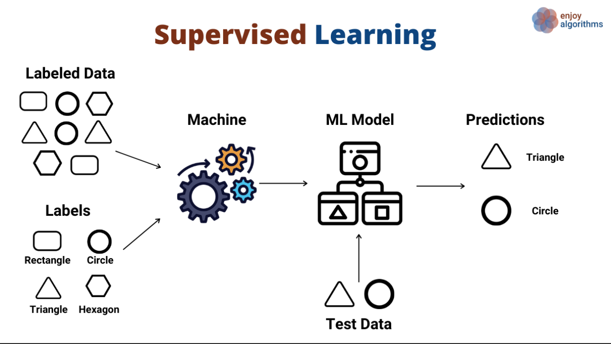

Slide 7
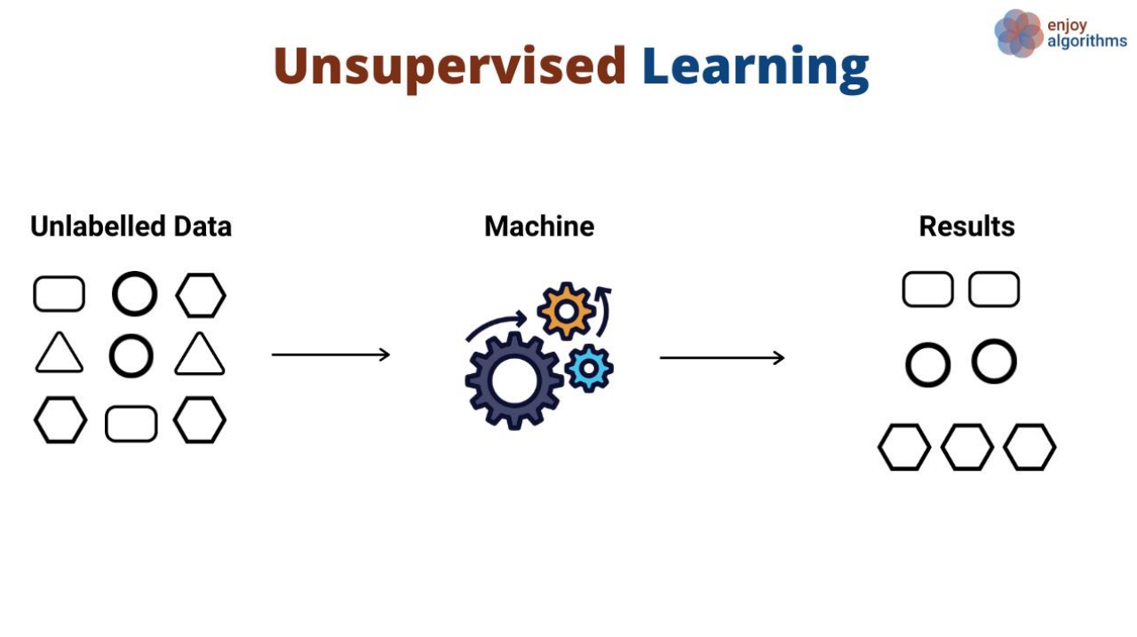

Slide 8
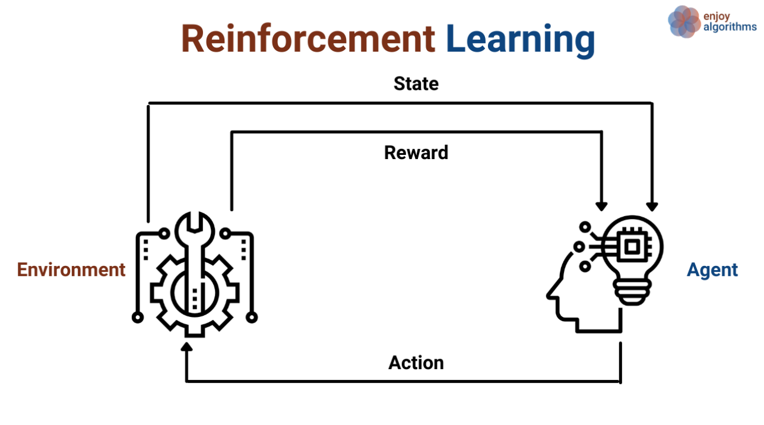

Slide 9
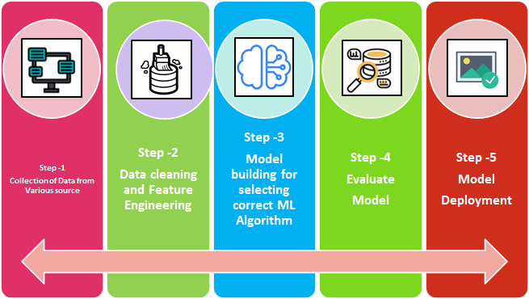
Machine Learning Process

Slide 10
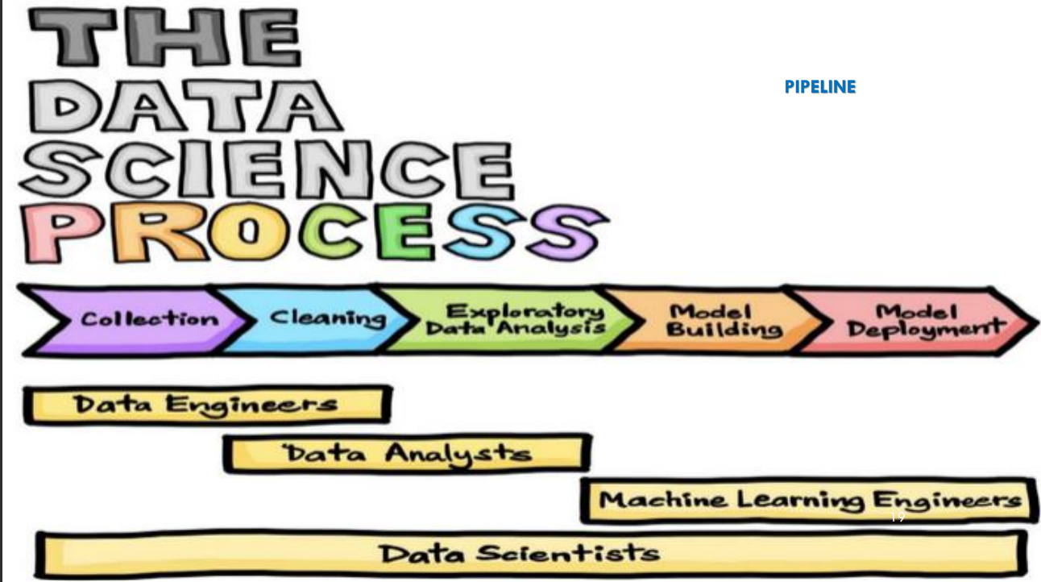

Slide 11
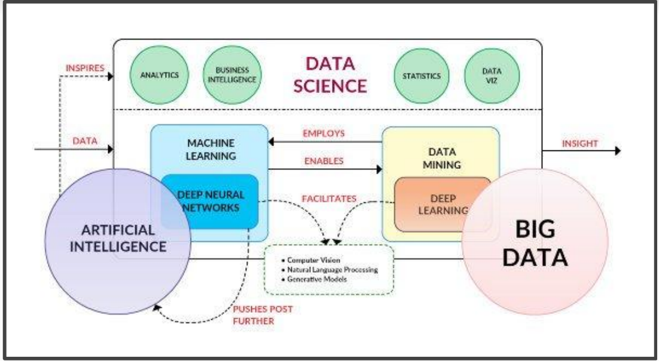
Data Science

Slide 12
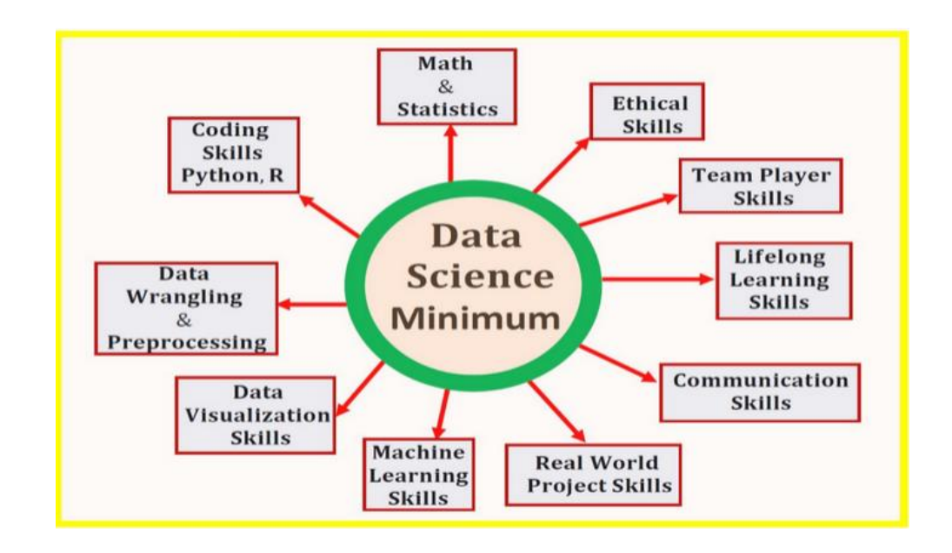
Data Science

Slide 13
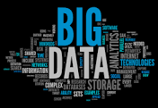
Big data:
refers to large and complex sets of data that are beyond the capacity of traditional data processing and management tools to handle effectively. Big data is characterized by the three Vs:
Volume: Big data involves a massive amount of data. This data can range from terabytes to petabytes or even exabytes in size. Traditional databases and data processing systems are not equipped to handle such enormous data volumes.
Velocity: Data in the big data context often comes in at high speeds. This can include data streaming in real-time from various sources like social media, sensors, and web applications. Managing and processing data at these high velocities requires specialized tools and techniques.
Variety: Big data encompasses diverse types of data, including structured data (e.g., databases and spreadsheets), semi-structured data (e.g., XML, JSON), and unstructured data (e.g., text documents, social media posts, images, and videos). This variety of data types adds complexity to data processing and analysis.

Slide 14
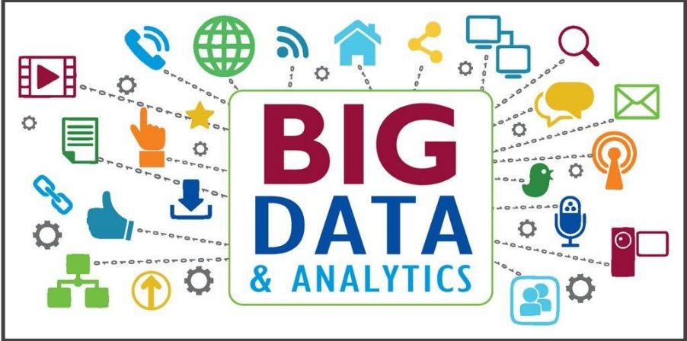

Slide 15
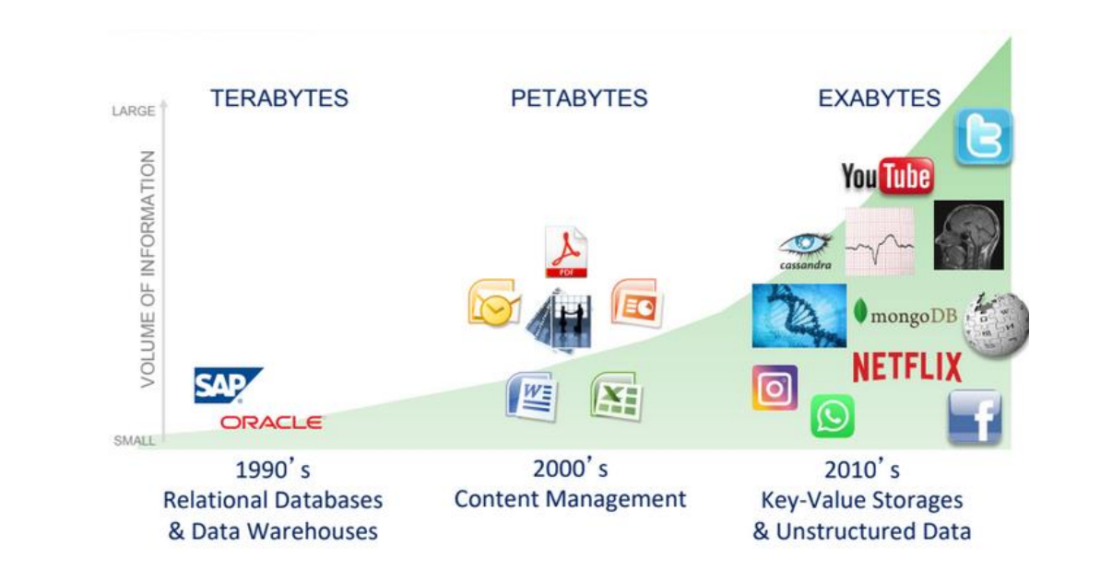

Slide 16
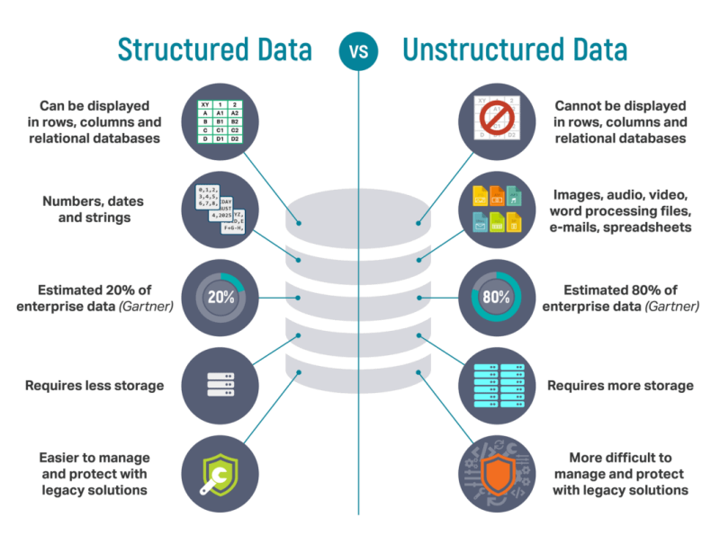

Slide 17
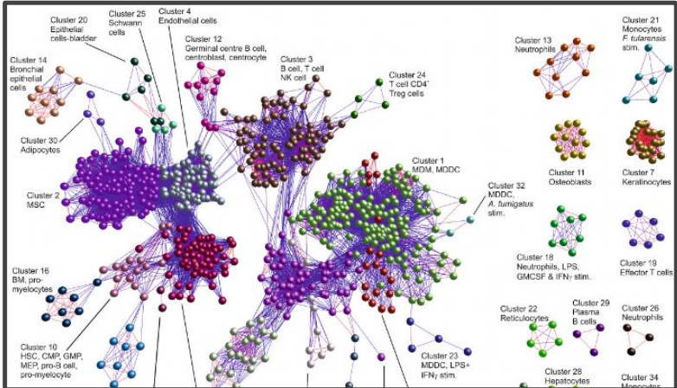
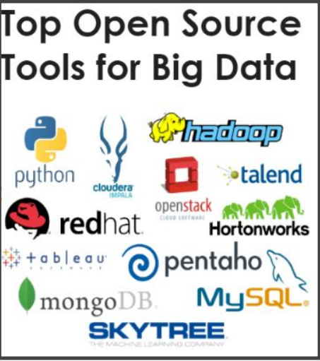
Big data Processing

Slide 18
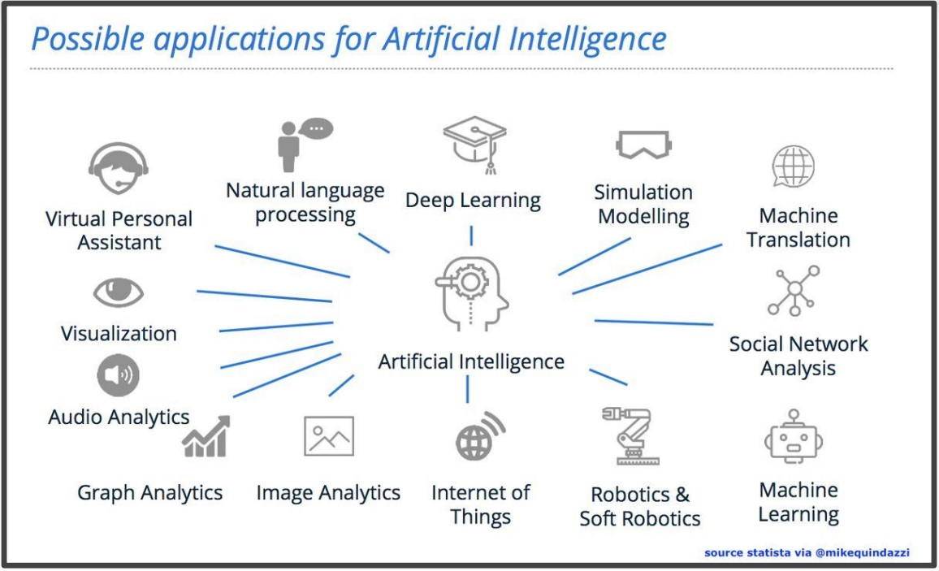

Slide 19
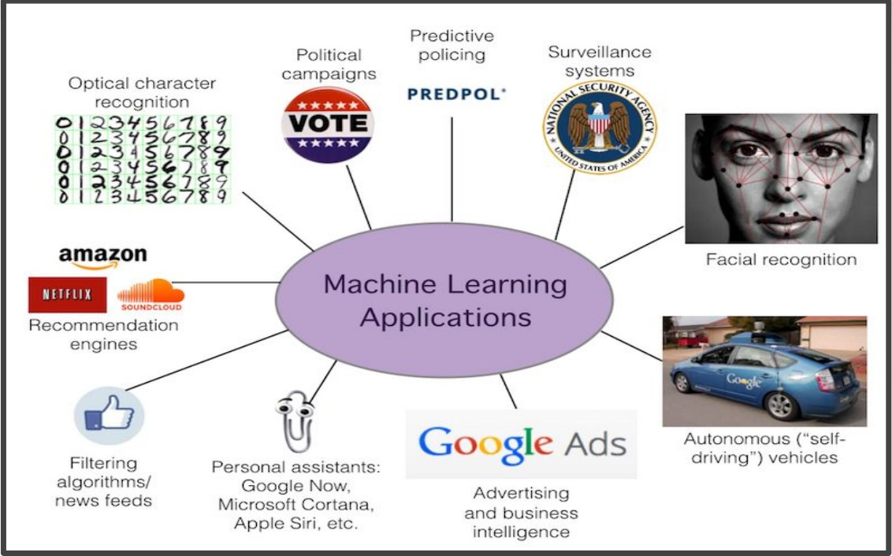

Slide 20
Course content:
▰ Getting Started with Python
▰ Mathematical Library with NumPy (Linear Algebra)
▰ Data Preprocessing and Visualization with Pandas & Matplotlib
▰ Supervised Machine Learning (Classification & Regression)
▰ Unsupervised Machine Learning (Clustering)
▰ Advanced Machine Learning
▰ Introduction to Deep Learning
▰ Introduction to Computer Vision
▰ Introduction to Natural Language Processing (NLP)

Slide 21

Why use Python in machine learning?
▰ Wide range of libraries
▰ Easy to use and learn
▰ Large community support
▰ Interoperability with other languages
▰ Scalability

Slide 22

PYTHON (JUPYTER NOTEBOOK):
▰ Most Preferred Programming Language in 2023 Recently used in
▰ most applications of Computer Science
▰ Jupyter Notebook is an open-source web app and the preferred IDE of Python since it organizes your code very well. Additionally, some similar platforms support it (Kaggle – Google Collab)
Interesting Fact:
Jupyter is a reference to
3 Programming Languages
Julia, Python, R

Slide 23
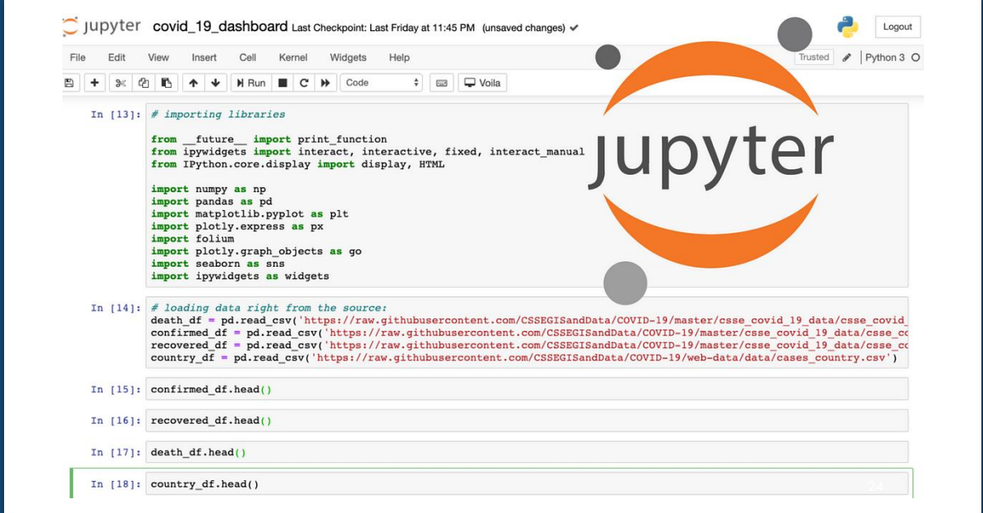

Slide 24
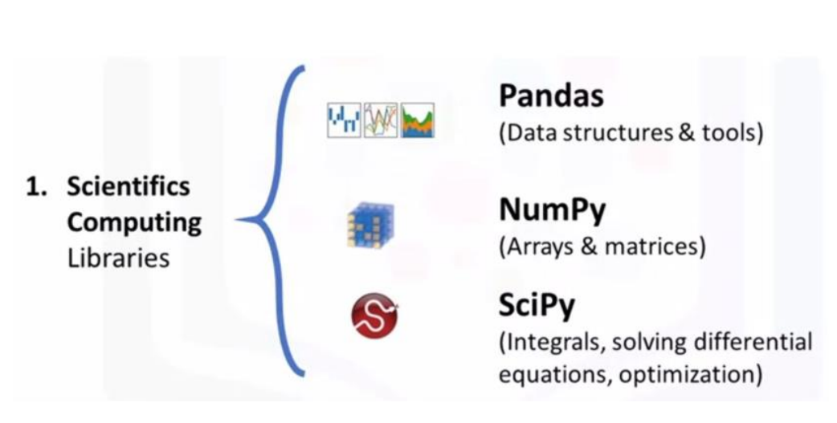
Python Libraries

Slide 25
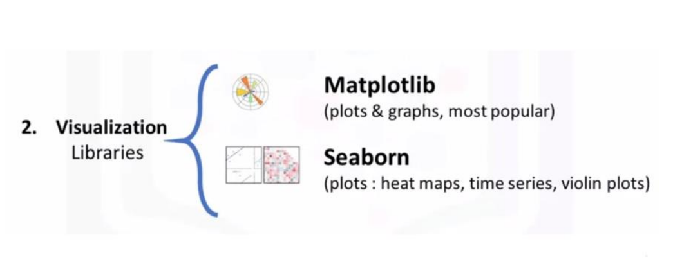
Python Libraries

Slide 26
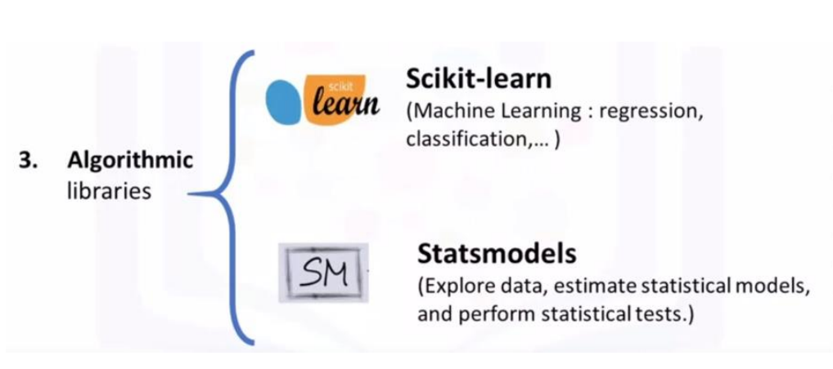
Python Libraries

Slide 27

Python Libraries
TENSORFLOW & PYTORCH

Slide 28

USING ANACONDA PLATFORM

Slide 29

▰ Download Anaconda From The Given Link
(anaconda.com)

Slide 30

SETUP YOUR KAGGLE ACCOUNT :
▰ The Biggest Data Science and Machine Learning Platform in the world.
▰ It provides a HUGE number of Datasets freely to be used in the projects.
▰ There are some free courses for short hours of some topics such as (Data Visualization, Data Analysis, Machine Learning, Advanced Machine Learning … etc).

Slide 31

Git & GitHub:
GitHub is a web-based platform for version control and collaboration that allows developers and teams to work on software projects together. It provides a wide range of tools and features for managing and tracking changes to code, collaborating with other developers, and hosting and sharing software projects.

Slide 32
Important Links:
▰ Home - UCI Machine Learning Repository
▰ Numpy_Cheat_Sheet.pdf (datacamp.com)
▰ Pandas_Cheat_Sheet.pdf (datacamp.com)
▰ Matplotlib_Cheat_Sheet.pdf (datacamp.com)

Slide 33
Tasks:
▰ Install Anaconda
▰ Prepare Kaggle Account
▰ Prepare GitHub Account
▰ Write First Jupyter Notebook
Code For testing

Slide 34
In mathematics, the symmetric difference of two sets is the set of elements which are in either of the sets, but not in their intersection.
Two following sets are given:
A = {2, 4, 6, 8}
B = {4, 10}
Using the appropriate method, extract the symmetrical difference of sets A and B and print the result to the console as shown below.
Expected result:
Symmetric difference: {2, 6, 8, 10}

Slide 35
The variable x:
x = -1.5
and the following expression are given:
expression = 'x**2 + x'
Using the appropriate function, calculate the value of this expression and print the result to the console.
Tip: Use the eval() function.
Expected result:
0.75

Slide 36
The following variables are given:
var1 = 'Python'
var2 = ('Python')
var3 = ('Python',)
var4 = ['Python']
var5 = {'Python'}
Using the appropriate function, check if the variables are instances of tuple class. Print the result to the console as shown below.
Tip: Use the isinstance() built-in function.
Expected result:
False
False
True
False
False

Slide 37
The following list is given:
characters = ['k', 'b', 'c', 'j', 'z', 'w']
Using the built-in functions, return the first and the last letter in alphabetical order from this list and print the result to the console as shown below.
Tip: Use the min() and max() functions.
Expected result:
First: b
Last: z

Slide 38


Thank You

